Slide 1



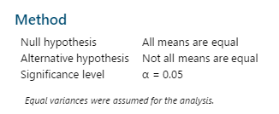

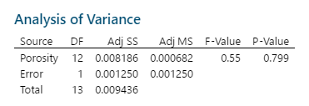
POSTER PRESENTATION By MINITAB USAGE
USAGE OF MINITAB
Here Minitab is used for various statistical data analysis. From Histogram to ANOVA including Boxplot, Pie and Pareto chart, Bubble Plot, Scatterplot etc all of these are plotted here by means of MINITAB.
ABOUT MINITAB???
Minitab is a command and menu driven software package for statistical analysis
Histogram
Bubble Plot
Scatterplot
Missing button 53 0.17 36.89
Loose thread 21 0.89 59.63
Misaligned fabric 18 5.12 92.16
Fabric flaws 23 4.89 112.47
Stitching errors 112 1.89 211.68
Hemming errors 43 4.23 181.89
Hydrogen Porosity Strength
0.180000 0.500150 0.83931
0.210000 0.410000 1.12253
0.210000 0.450000 1.11309
0.210000 0.550000 1.10000
0.220000 0.440000 0.70705
0.220000 0.240000 0.49751
0.230000 0.470000 0.53000
0.230000 0.700000 0.52062
0.240000 0.800000 0.19287
0.240000 0.220000 0.54000
0.250000 0.880000 0.39086
0.260000 0.720000 0.42000
0.270000 0.750000 0.18348
0.280000 0.700000 0.24000
Pie Chart
Cause and effect diagram
Boxplot
Contact
Md Asif Newaz Khan
Roll:201636053
Level: 03
IPE-01
Military Institute of Science and Technology
ANOVA
Probability Plot
Pareto Chart

